Slide 1

Overview of Azure Stack Hub
What is Azure Stack Hub?
This work is licensed under a Creative Commons Attribution - ShareAlike 4.0 International Public License

Slide 2
Agenda
Azure Stack Hub Overview
Azure Stack Hub Architecture
Azure Stack Family of Devices

Slide 3
Azure Stack Hub
Complete autonomous cloud
Only consistent hybrid cloud that can run at the connected or disconnected
Azure connected or disconnected cloud
Consistent application development and operations
Common application model, tools and APIs with Azure simplifying DevOps
Regulatory & data sovereignty
Azure Services available on-premises
Azure web services, containers, Azure functions, and Azure marketplace
Purpose-built integrated system
Cloud inspired infrastructure via integrated systems from major H/W partners
Application modernization

Slide 4
Azure Stack Hub: An extension of Azure
Consistent application development
Azure services
available on-premises
Purpose-built
integrated system

Slide 5
Azure Stack Hub
Consistent application development
Azure services
available on-premises
Purpose-built
integrated system
Tools
Experiences
Deployments
Application patterns
Automations
Operations

Slide 6












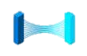
Azure Stack Hub: Today… and tomorrow
Consistent application development
Azure services
available on-premises
Purpose-built
integrated system
Available now
Service Fabric
Azure Functions
Key Vault
Azure App Service
Azure Marketplace
Virtual Machines
Kubernetes using AKS engine
Storage
Blockchain
Stream Analytics
Networking
Databases
API Management
GA
In development
Azure Kubernetes Service (AKS)
Cognitive Services
- In Preview -
Event Hubs
Public Preview
Container Registry
Public Preview
Azure Arc
Several Previews
SQL Server 2019
Support AI & Analytics

Slide 7
Azure Stack Hub
Consistent application development
Azure services
available on-premises
Purpose-built
integrated system
Architecture, hardware, and topology
Deployment, configuration, provisioning
Validation
Monitoring, diagnostics
Security and privacy
Business continuity
Patching and updates
Field replacement of parts

Slide 8

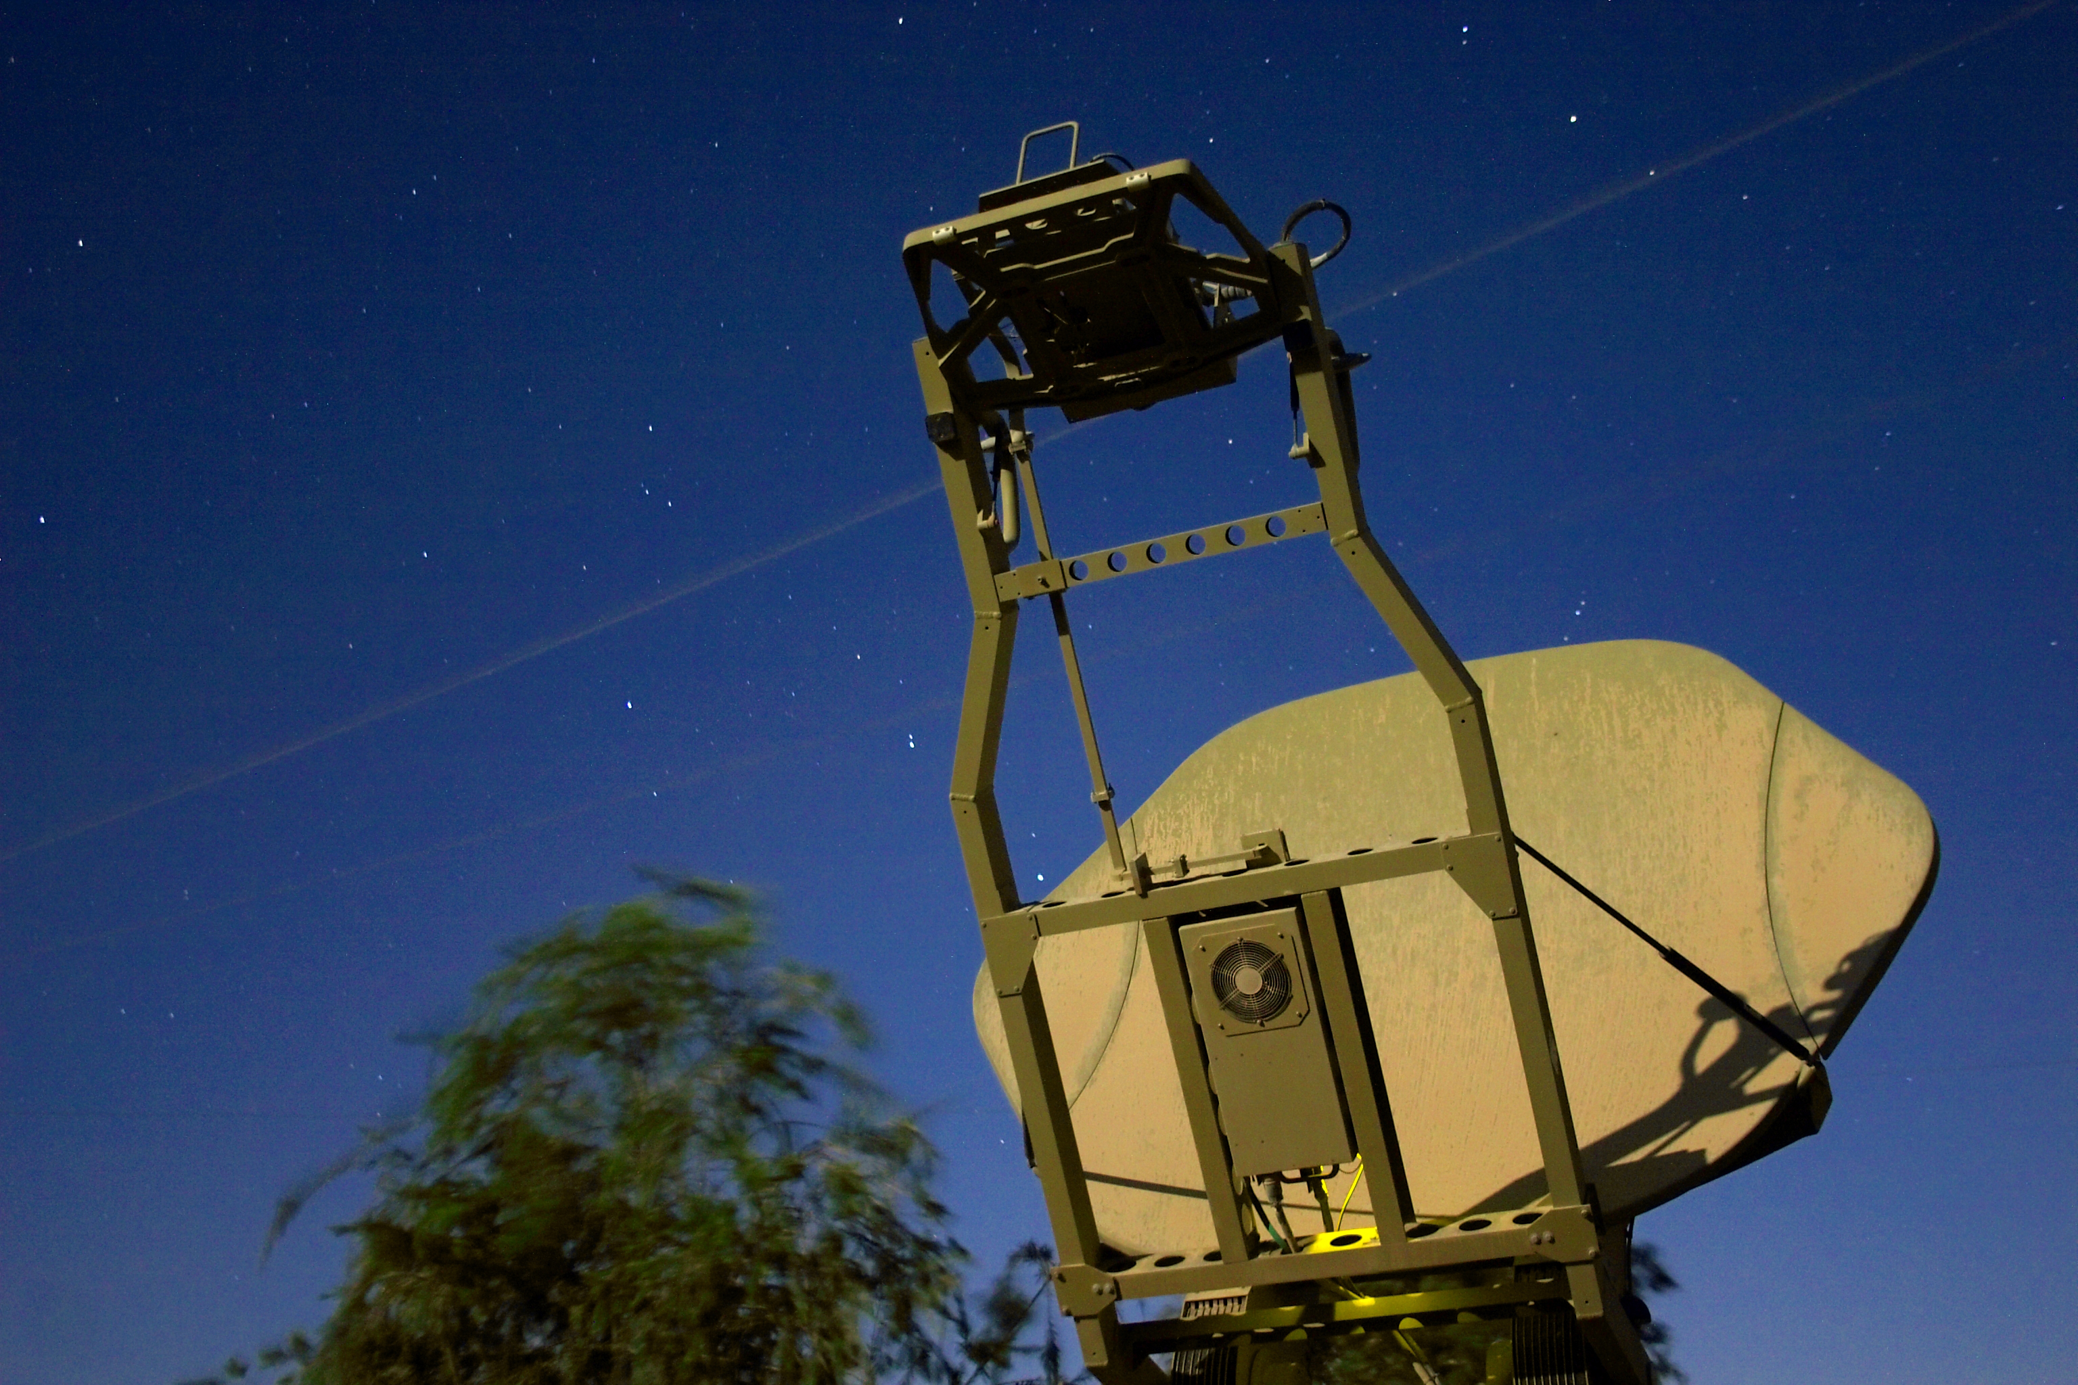
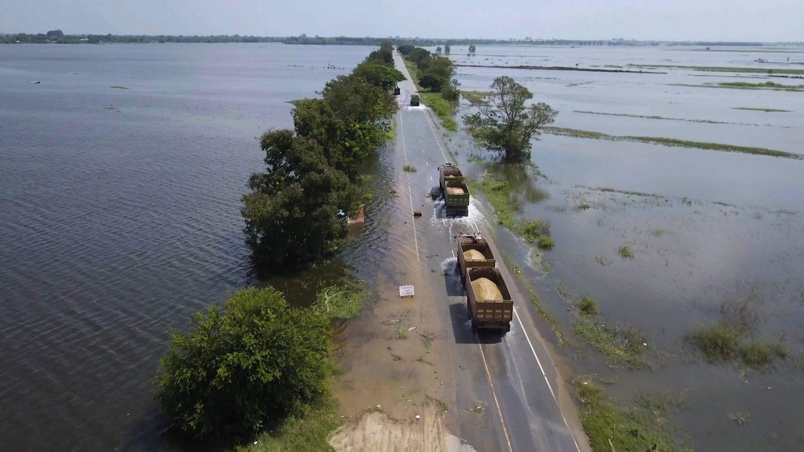
Use Cases
Cloud capability in disconnected environments
Manage and operate IoT networked systems in theater
Humanitarian assistance and disaster response

Slide 9
Targeted Customers and Scenarios
Offline/remote storage and data processing
Real-time AI inferencing of field surveillance data
Legacy data center replacement
Multi-device rugged edge scenario
Disaster response
Mobile command centers
National Security event support
Disaster scenario HA/backup solutions
Flexible IT pod solution for workloads with data sovereignty requirements

Slide 10
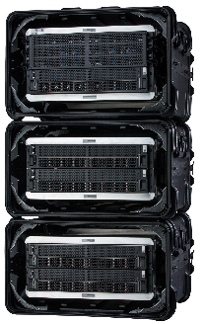
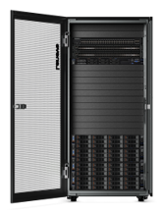
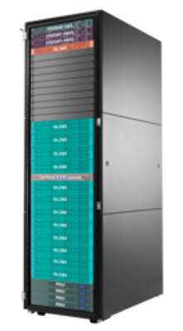
Azure Stack Hub Sample Configurations
4 Node Ruggedized
8 Node Dense
16 Node Hybrid
4 Node Azure Stack Hub
Physical Cores: 66
Usable storage: 34.3 TB
Usable Memory: 1444 GB
8 Node Azure Stack Hub
Physical Cores: 578
Usable storage: 189.4 TB
Usable Memory: 8097 GB
16 Node Azure Stack Hub
Physical Cores: 1192
Usable storage: 468.1 TB
Usable Memory: 7176 GB

Slide 11
3P Billing, Licensing, & Support Models

Slide 12
3P Azure Pricing Model Review

Slide 13
Azure Pricing Concepts
There are three main offerings for Azure:
Microsoft Azure Services
Microsoft Azure
Marketplace
Microsoft Azure Plans
Metered resources
For variable deployment needs
Pay for what you use or full capacity
Examples
Virtual machines
Storage
Content delivery (CDN)
3rd party offers
Pay via BYOL (or PAYG billing for Windows VMs only – no 3rd party payments through Azure Stack Hub marketplace yet)
For Azure based solutions
Examples
SendGrid
MongoDB
Oracle DB
Pre-configured resources
Pre-pay for annual coverage
For predictable deployments
Examples
OMS
IoT Suite
Azure Support

Slide 14
3P OEM Purchased as an integrated system
Purchased directly from hardware partners, including support and installation services.
The OEM can provide the customer different options for funding and buying the Azure Stack Hub hardware
Hardware
Support
One integrated experience.
Azure Stack Hub
services
Billed by Microsoft via EA or CSP,
support via Premier or Azure agreement.

Slide 15
3P Licensing Models

Slide 16
Pay-as-you-go model
Also known as Consumption model
Consistent with Azure: same subscriptions, monetary commitment, invoice
Fee for consumption: only pay for workloads running on Azure Stack Hub (fabric VMs are not charged)
No upfront licensing fees: don’t pay until you use the service
Available in EA and CSP channels
Azure Stack Hub
Hosted and On-premises

Slide 17
Pay as you go is similar to Azure Services
Virtual machines
Web sites
SQL and MySQL
Mobile services
Automation
Azure AD
VM Images
Storage
Pay-as-you-Use
Metered usage
Pay for the exact resources consumed (e.g., a GB of storage, an hour of virtual machines)

Slide 18
Pay-as-you-go pricing - Example
 | Service | Microsoft charges
Up-Front Licensing | Azure Stack Hub initial deployment | $0 | no upfront licensing fees
Consumption-Based Fees | Cloud Infrastructure; Management, Security, & Identity; Networking; Service Fabric | $0
 | Virtual Machines: Base VM | $0.008/vCPU/hour | ($6/vCPU/month)
 | Virtual Machines: with Windows Server | $0.046/vCPU/hour | ($34/vCPU/month)
 | Azure Blob Storage Service | $0.006/GB/month
 | Azure Tables & Queues Storage Service | $0.018/GB/month
 | Azure Standard Unmanaged Disk | $0.011/GB/month
 | Azure Managed Disks (fixed sizes between 32GB – 1TB) | $0.385/unit*/month | * units are 32GB
 | Azure App Service (including Functions) | $0.056/vCPU/hour | ($42/vCPU/month)
 | Event Hubs | $0.2688/core/hour
Customers can bring their own Windows Server and SQL Server licenses to run on Base VM images
Windows Server BYOL – must license the entire region
New services may add new billable services to Azure Stack Hub

Slide 19
Capacity model
For disconnected scenarios, when usage metering and connection to Azure Commerce are not possible
Fixed fee, annual subscription: based on number of physical cores
License all physical cores on a stamp, with unlimited use rights
Separate transaction from Azure: cannot use monetary commit, different billing
EA channel only
Azure Stack Hub
Hosted and On-premises

Slide 20
Capacity model pricing
App Service Package
$per/core/year
Includes: App Service, Base VM, Azure Storage
Must license all physical cores on the deployment
Windows Server and SQL Server are BYOL (on-premises license)
IaaS Package
$per/core/year
Base VM, Azure Storage only
Must license all physical cores on the deployment
Windows Server and SQL Server are BYOL (on-premises license)

Slide 21

Implications of the capacity licensing model
Capacity-based licensing model is for customers who have specific requirements
Disconnected or regulatory
Billing models
Requires an EA with Azure enrollment
Not available to CSPs
Customer purchases an annual subscription to services (no perpetual use rights)
Billing is not usage based, and not through Azure subscriptions
Consumption provides the best value for most customers
May be a familiar model but not consistent with transacting modern cloud-native services
Changing your licensing model requires a redeployment of the stamp. (Pay-as)

Slide 22

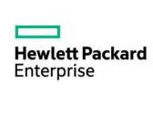








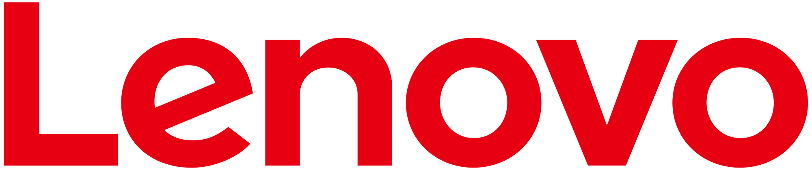
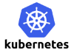




Ecosystem
Integrated systems
Azure Marketplace

Slide 23
Azure Stack Hub architecture overview

Slide 24
Delivering Azure Stack Hub as an integrated system
Software
Hardware
Support
Services

Slide 25

Azure Stack Hub integrated system
Software
Hardware
Support
Services
Architecture, hardware, and topology
Deployment, configuration, provisioning
Validation
Monitoring, diagnostics
ToR Switch
ToR Switch
BMC Switch
Azure Stack Hub
integrated system
Security and privacy
Business continuity
Patching and updating
Field replacement of parts
Server
Server
Server
Server

Slide 26
Azure Stack Hub hardware requirements: Network switches*
Top-of-rack switches
2 switches per scale unit, configured for resiliency
10 GbE or better for server connectivity
Support for BGP, DCB, PFC, ETS, and Multi-Chassis Link Aggregation
BMC / management network switch
1 GbE switch capable of L3 routing and simultaneous connectivity to the ToRs
*Single scale unit

Slide 27

Cloud operating model
operate
use
Azure
Azure customers
Microsoft engineers
use
operate
Azure Stack Hub instance
Your customers
Your engineers
Cloud Architect – Design
Cloud Operator – Operate Azure Stack Hub

Slide 28
Infrastructure software – What runs where?
Appliance-like architecture and deployment
Servers: Windows Server 2016/2019
Compute / Storage / Network
All infrastructure roles are hosted in VMs
Resiliency, scalability, change in features
VMs get re-deployed during patch and update (replace instead of patch)
These VMs run Windows Server 2016/2019
Azure Stack Hub customer and cloud administrator
Tenant and Admin Portal

Slide 29
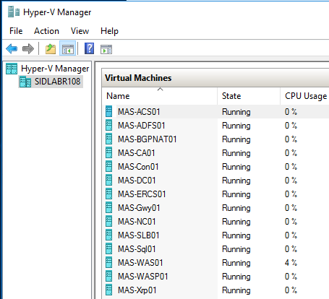
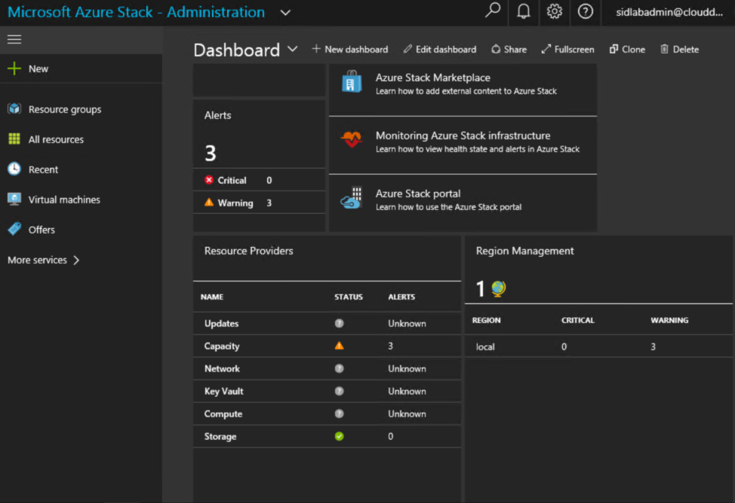
I’m an admin, what’s my focus?
https://adminportal.local.azurestack.external
Traditional Virtualization Management
Cloud-based Management
Management of Azure Stack Hub is performed within the portal and cannot be managed like traditional virtualization platform solutions

Slide 30
Azure Stack Hub core infrastructure roles
Role Name | components or services description
AzS-ACS01 | Azure Stack Hub storage services.
AzS-ADFS01 | Active Directory Federation Services (ADFS).
AzS-BGPNAT01 | Edge router and provides NAT and VPN capabilities for Azure Stack Hub. (only for ASDK)
AzS-CA01 | Certificate authority services for Azure Stack Hub role services.
AzS-DC01 | Active Directory, DNS, and DHCP services for Microsoft Azure Stack Hub.
AzS-ERCS01 | Emergency Recovery Console VM.
AzS-GWY01 | Edge gateway services such as VPN site-to-site connections for tenant networks.
AzS-NC01 | Network Controller, which manages Azure Stack Hub network services.
AzS-SLB01 | Load balancing multiplexer services in Azure Stack Hub for both tenants and Azure Stack Hub infrastructure services.
AzS-SQL01 | Internal data store for Azure Stack Hub infrastructure roles.
AzS-WAS01 | Azure Stack Hub administrative portal and Azure Resource Manager services.
AzS-WASP01 | Azure Stack Hub user (tenant) portal and Azure Resource Manager services.
AzS-XRP01 | Infrastructure management controller for Microsoft Azure Stack Hub, including the Compute, Network, and Storage resource providers.

Slide 31
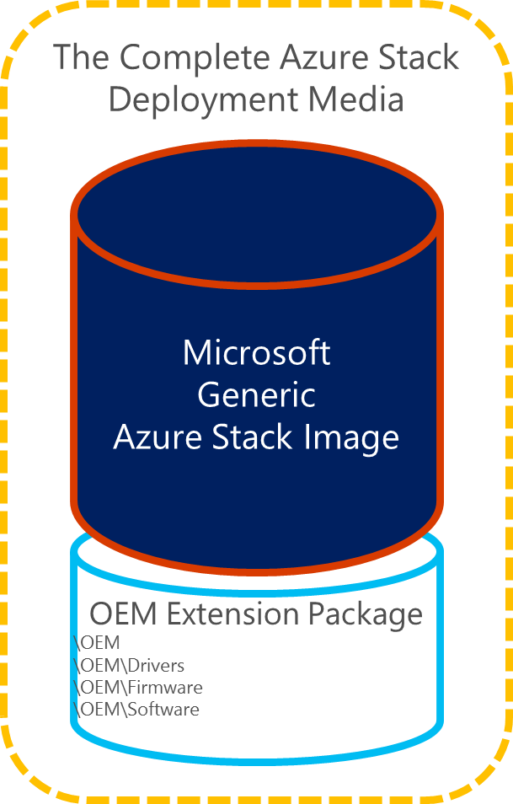
Hardware lifecycle host (HLH)
Definition
A server connected to the BMC Network that is external to the Azure Stack Hub environment
Available to run partner’s lifecycle management software within VMs
Purpose
Hardware monitoring software
Firmware configuration and update software
Emergency management and hardware troubleshooting
Running the Azure Stack Hub Deployment Virtual Machine (DVM) for the duration of initial deployment
Configuration
Network connection to the BMC switch
Windows Server 2016 Standard or Datacenter Edition
Enabled with Hyper-V role
Meets Azure Stack Hub security requirements

Slide 32



Azure Stack Hub concepts
Scale Unit
Region
Cloud
Associated with a single Region
1 or more Scale Units within a Region
Unit of capacity expansion
4 or more servers within a scale unit
Fault domains (Azure consistency)
Alignment of Hardware SKU – which is homogenous within Scale Unit
Set of Scale Units that share same “physical location”
Under one physical and logical “administrator”
Networking requirements
High-bandwidth/low latency
Flat, layer-3 network
Other attributes are implied by customer choices
Scale unit may have different type of hardware from same vendor
Single instance of Azure Resource Manager (ARM)
1 or more Regions under management of ARM
Supports different hardware vendors across multiple regions

Slide 33
Border
Device
Scale Unit
ToR Switch
ToR Switch
BMC Switch
Server
Server
Server
Server
HLH

Slide 34
Azure Stack Hub capacity, scalability, and redundancy

Slide 35
Azure Stack Hub: Inputs to capacity planning
Servers
Cores
Memory
Storage devices (capacity)
NIC performance
Storage performance
Infrastructure use (VMs + software update)
Application behaviors

Slide 36
Azure Stack Hub scale unit
Tenant Capacity
Patch and Update Reserve
Infrastructure Services
Server
Server
Server
Server

Slide 37
Azure Stack Hub scale unit – Adding server nodes…
Tenant Capacity
Tenant Capacity
Note – Servers can be added individually up to 16 nodes per scale unit
Patch and Update Reserve
Infrastructure Services
Server
Server
Server
Server
Server
Server
Server
Server

Slide 38
Azure Stack Hub Compute

Slide 39
Compute
Azure Resource Manager
vNICs, …
VMs, VM Extensions, Platform Images
Storage Accounts
Blobs, Tables, …
Compute Resource Provider
Azure Guest Agent
Hyper-V Clusters
Networking
Compute
Storage

Slide 40
VM sizes on Azure Stack Hub
Azure Stack Hub supports a subset of VM sizes
Currently we have support for A, D, DS and F
Emulation is imperfect and is focused on uniform in-guest quantities
RAM, CPU, Disk size quantities are aligned to Azure
Storage performance is likely to be significantly better than Azure
CPU performance is better than Azure for low-load environments
CPU performance is non-deterministic for a given VM size (A VM size may run faster than a Dv2)
Entry level
A
Av2
General Purpose
D
Dv2
DS
DSv2
Compute Intensive
F
Fv2
FS
FSv2
Virtual machine sizes supported in Azure Stack Hub
https://docs.microsoft.com/en-us/azure/azure-stack/user/azure-stack-vm-sizes

Slide 41
Azure Stack Hub Networking

Slide 42
Networking
Azure Resource Manager
vNICs, GWs, SLBs, vNets, ACLs…
VMs, VM Extensions, Platform Images
Storage Accounts
Blobs, Tables, …
Network Resource Provider Network Controller Software Load Balancer
Data Plane vSwitch, Gateway
Networking
Compute
Storage

Slide 43
Physical network switch topology
Two connectivity types in Azure Stack Hub
DATA (Windows Server 2016 Converged NIC: SDN + Storage)
BMC (Physical host control + 3rd party hardware monitoring)
Resiliency is built in
DATA – Single physical NIC with dual ports (minimum 10Gb+)
Uses switch-embedded-teaming (WS2016) for port/link resiliency
Assumes dual-switch (ToR) configuration

Slide 44
Network switch connectivity – within scale unit
ToR-to-ToR
MLAG
ToR Switch
Switch Management
ToR Switch
Server – Port A
BMC Switch
Server – Port B
BMC – Server Management
Server
Server
Server
Server

Slide 45
Azure Stack Hub Storage

Slide 46
Storage
Azure Resource Manager
SLB, …
VMs, VM Extensions, Platform Images
Storage Accounts
Blobs, Tables, …
Storage Resource Provider Blob Service, Table Service, …
Scale Out File Server Storage Spaces Direct, ReFS
Networking
Compute
Storage

Slide 47
Azure-consistent storage
Delivers Azure-consistent Blobs, Tables, and Storage accounts
Comprehensive private cloud service provider manageability
Deployable in either enterprise-private clouds or hosted public clouds from service providers
IaaS storage (Page Blobs), and PaaS storage (Block Blobs, Tables)
Highly-reliable, resilient, and scalable cloud storage based on standard hardware
For Tenant
For Administrator
Azure-consistent blob service
Azure-consistent table service
Azure-consistent account service
Azure Stack Hub storage cloud admin service
Microsoft Azure Stack Hub w/ SRP
SMB3 Storage Network Fabric
Blob back-end
Scale-Out File Server (SOFS)
Blob back-end
. . . . .
Storage Spaces, Storage Spaces Direct (S2D), or SAN
Physical Storage

Slide 48
Storage stack
Storage Spaces
Single scalable pool with all disk devices (except boot)
Multiple virtual disks per pool (Mirrored)
Software Storage Bus
Storage Bus Cache
Leverages SMB3 and SMB Direct
Servers with local disks
SATA, SAS, and NVMe based on OEM SKU
Virtual Machines
CSVFS Cluster File System
ReFS On-Disk File System
Storage Spaces Virtual Disks
Storage Spaces Storage Pool
Software Storage Bus

Slide 49
Built-in cache
Cache is an integral part of Software Storage Bus
Scoped to local machine
Agnostic to storage pool and virtual disks
Automatic configuration when enabling Spaces Direct
Cache behavior is dependent on type of operation
SATA
SSD
SATA
SSD
Caching devices
SATA
HDD
SATA
HDD
SATA
HDD
SATA
HDD
Capacity devices
SATA
HDD
SATA
HDD

Slide 50
Azure Stack Hub volumes
Mirror spaces have resiliency granted from multiple data copies
Like Azure, data has three copies in Azure Stack Hub
Azure Stack Hub leverages a 3-way mirror
Normal mirror sets can survive the loss of a single physical disk
Azure Stack Hub 3-way mirror can survive the loss of two physical disks
Category | Detail
Volume type | Mirror
Optimized for | Performance
Use case | All data is hot
Efficiency | Least (33%)
File System | ReFS

Slide 51
Azure Stack Hub storage
Virtual Disks
Infrastructure
Temp Storage (one per server)
Tenant (logically – one per server; managed by ACS)
Add a Server
Add one Temp Storage virtual disk
Add one Tenant virtual disk
Mirrored (3-way for Infrastructure and Tenant) Physical Devices
2 or more Storage Spaces Direct cache devices
4 or more Storage Spaces Direct capacity devices

Slide 52

Azure Stack Hub storage redundancy
In Storage Spaces Direct for Azure Stack Hub, the default is to keep three copies of the data split between three server nodes
Azure Stack Hub VMs are clustered and split across three nodes
Three copies of all data written to disk
This means you can lose a whole server due to failure or during patch and update and still have 2-copy redundancy
256 MB #0019
COPY #0023
256 MB #0024
COPY #0021
COPY #0019
256 MB #0021
COPY #0020
256 MB #0022
COPY #0024
256 MB #0020
COPY #0022
256 MB #0023
COPY #0015
256 MB #0017
256 MB #0014
COPY #0013
256 MB #0015
COPY #0016
256 MB #0018
COPY #0014
256 MB #0016
COPY #0017
256 MB #0012
COPY #0018
256 MB #0011
COPY #0005
COPY #0010
256 MB #0008
COPY #0009
COPY #0012
256 MB #0010
COPY #0006
COPY #0011
256 MB #0009
COPY #0008
256 MB #0013
256 MB #0001
256 MB #0002
COPY #0003
COPY #0007
256 MB #0004
256 MB #0007
COPY #0002
256 MB #0003
256 MB #0005
COPY #0001
256 MB #0006
COPY #0004
Server 1
Server 2
Server 3

Slide 53
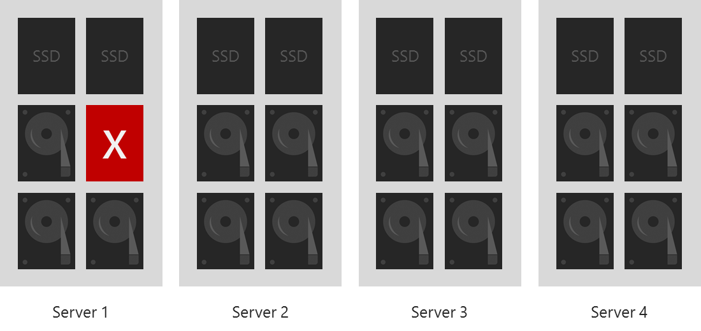
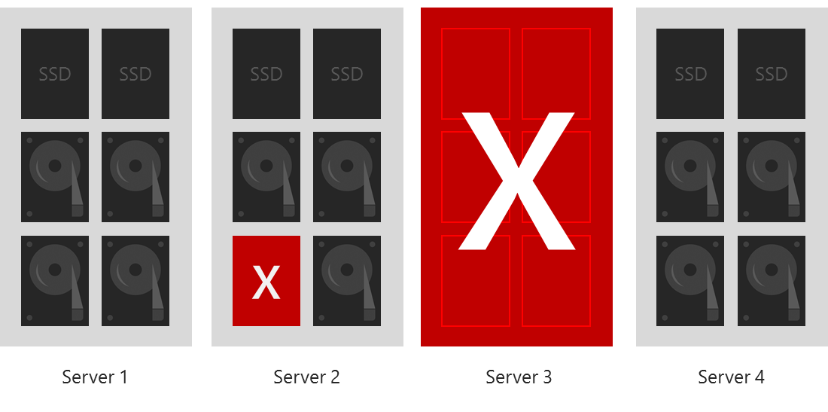
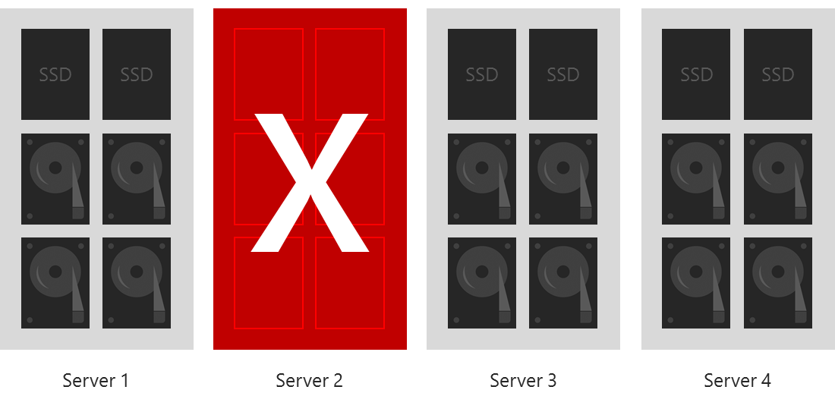
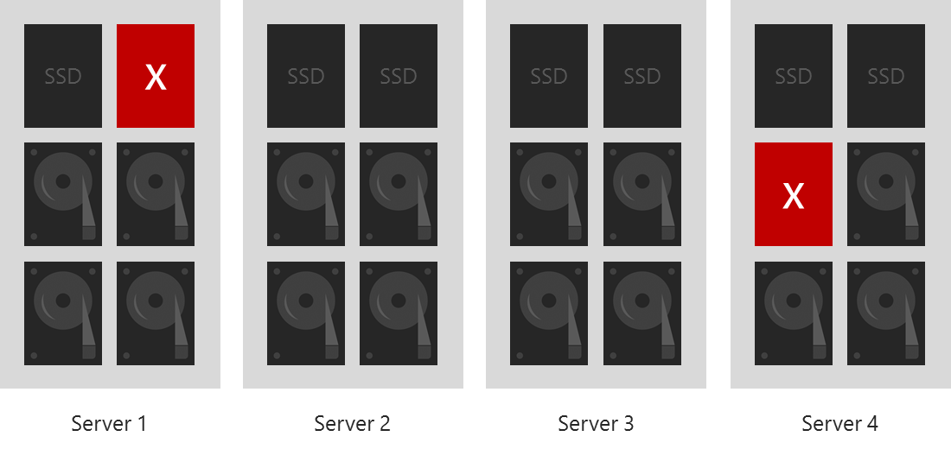
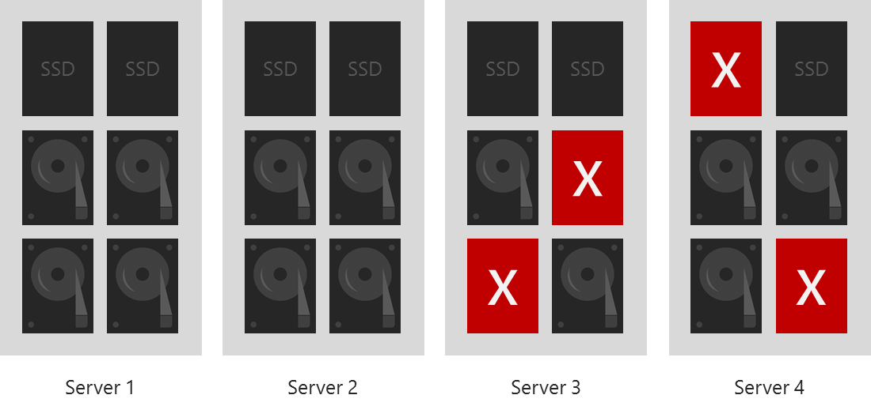
Survival examples

Slide 54
Azure Stack Hub scale unit resiliency
Switch resiliency
A single TOR or Aggregate switch can fail
Server resiliency
A single Server node can fail, as long as disk failures are limited to one other Server node
A third Server node down or failed disks in a third Server node will take the affected virtual disks offline
Disk resiliency
A single disk can fail anywhere in the scale unit
Multiple disks can fail, as long as they are limited to two server nodes
PDU resiliency
A single power supply or PDU can fail with no issues

Slide 55
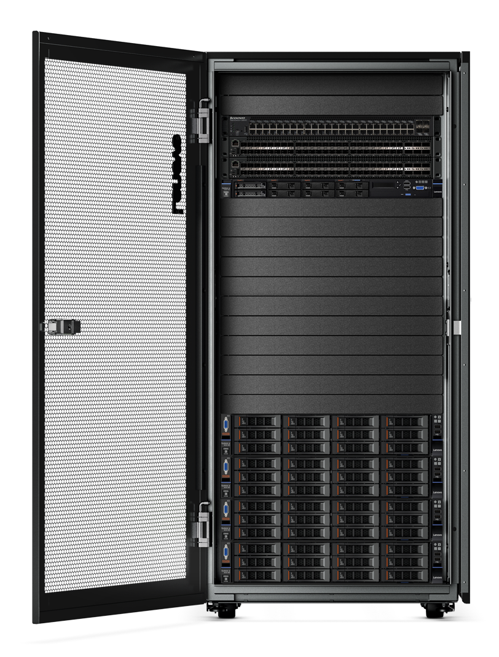
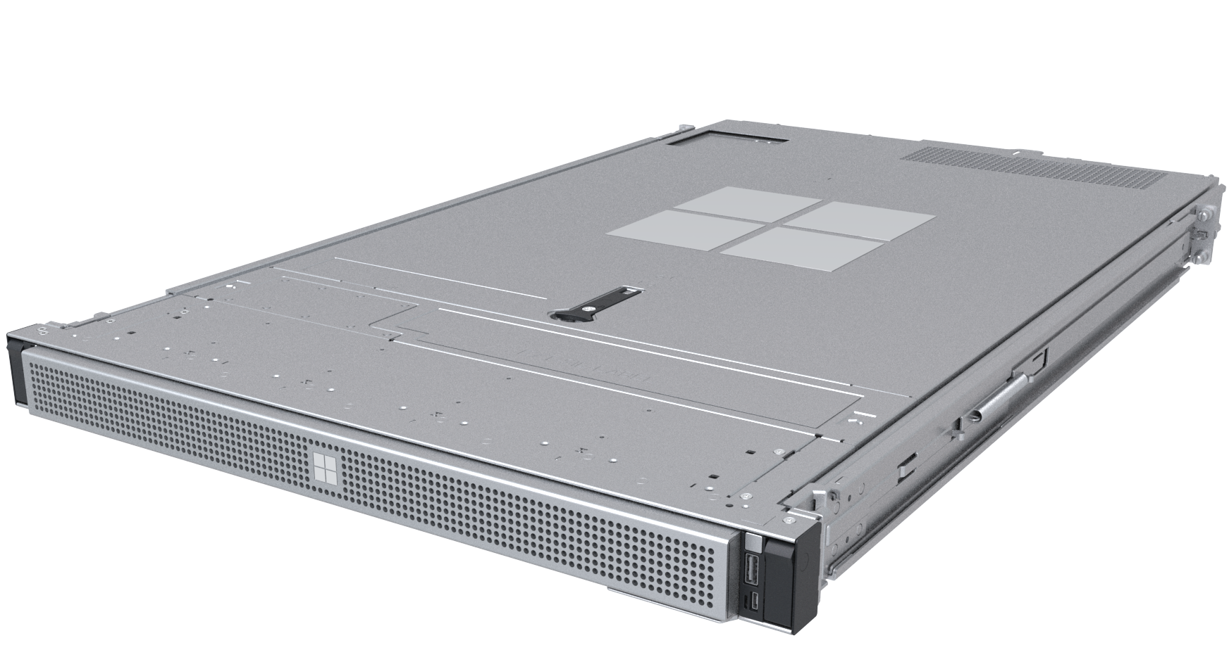
Family of Azure Stack products
Azure Stack Edge
Cloud-managed appliance
Azure Stack Hub
Cloud-native integrated system
Machine learning at the edge
Edge compute and IoT solutions
Network data transfer to cloud
Disconnected scenarios
Data sovereignty
Application modernization

Slide 56
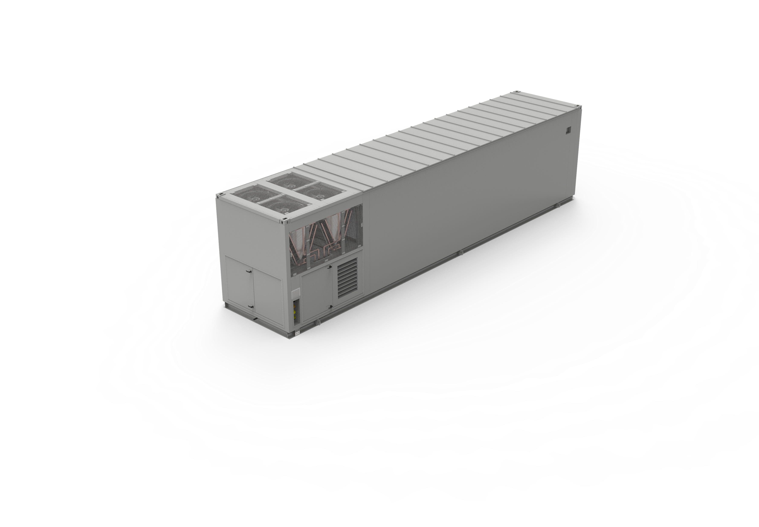
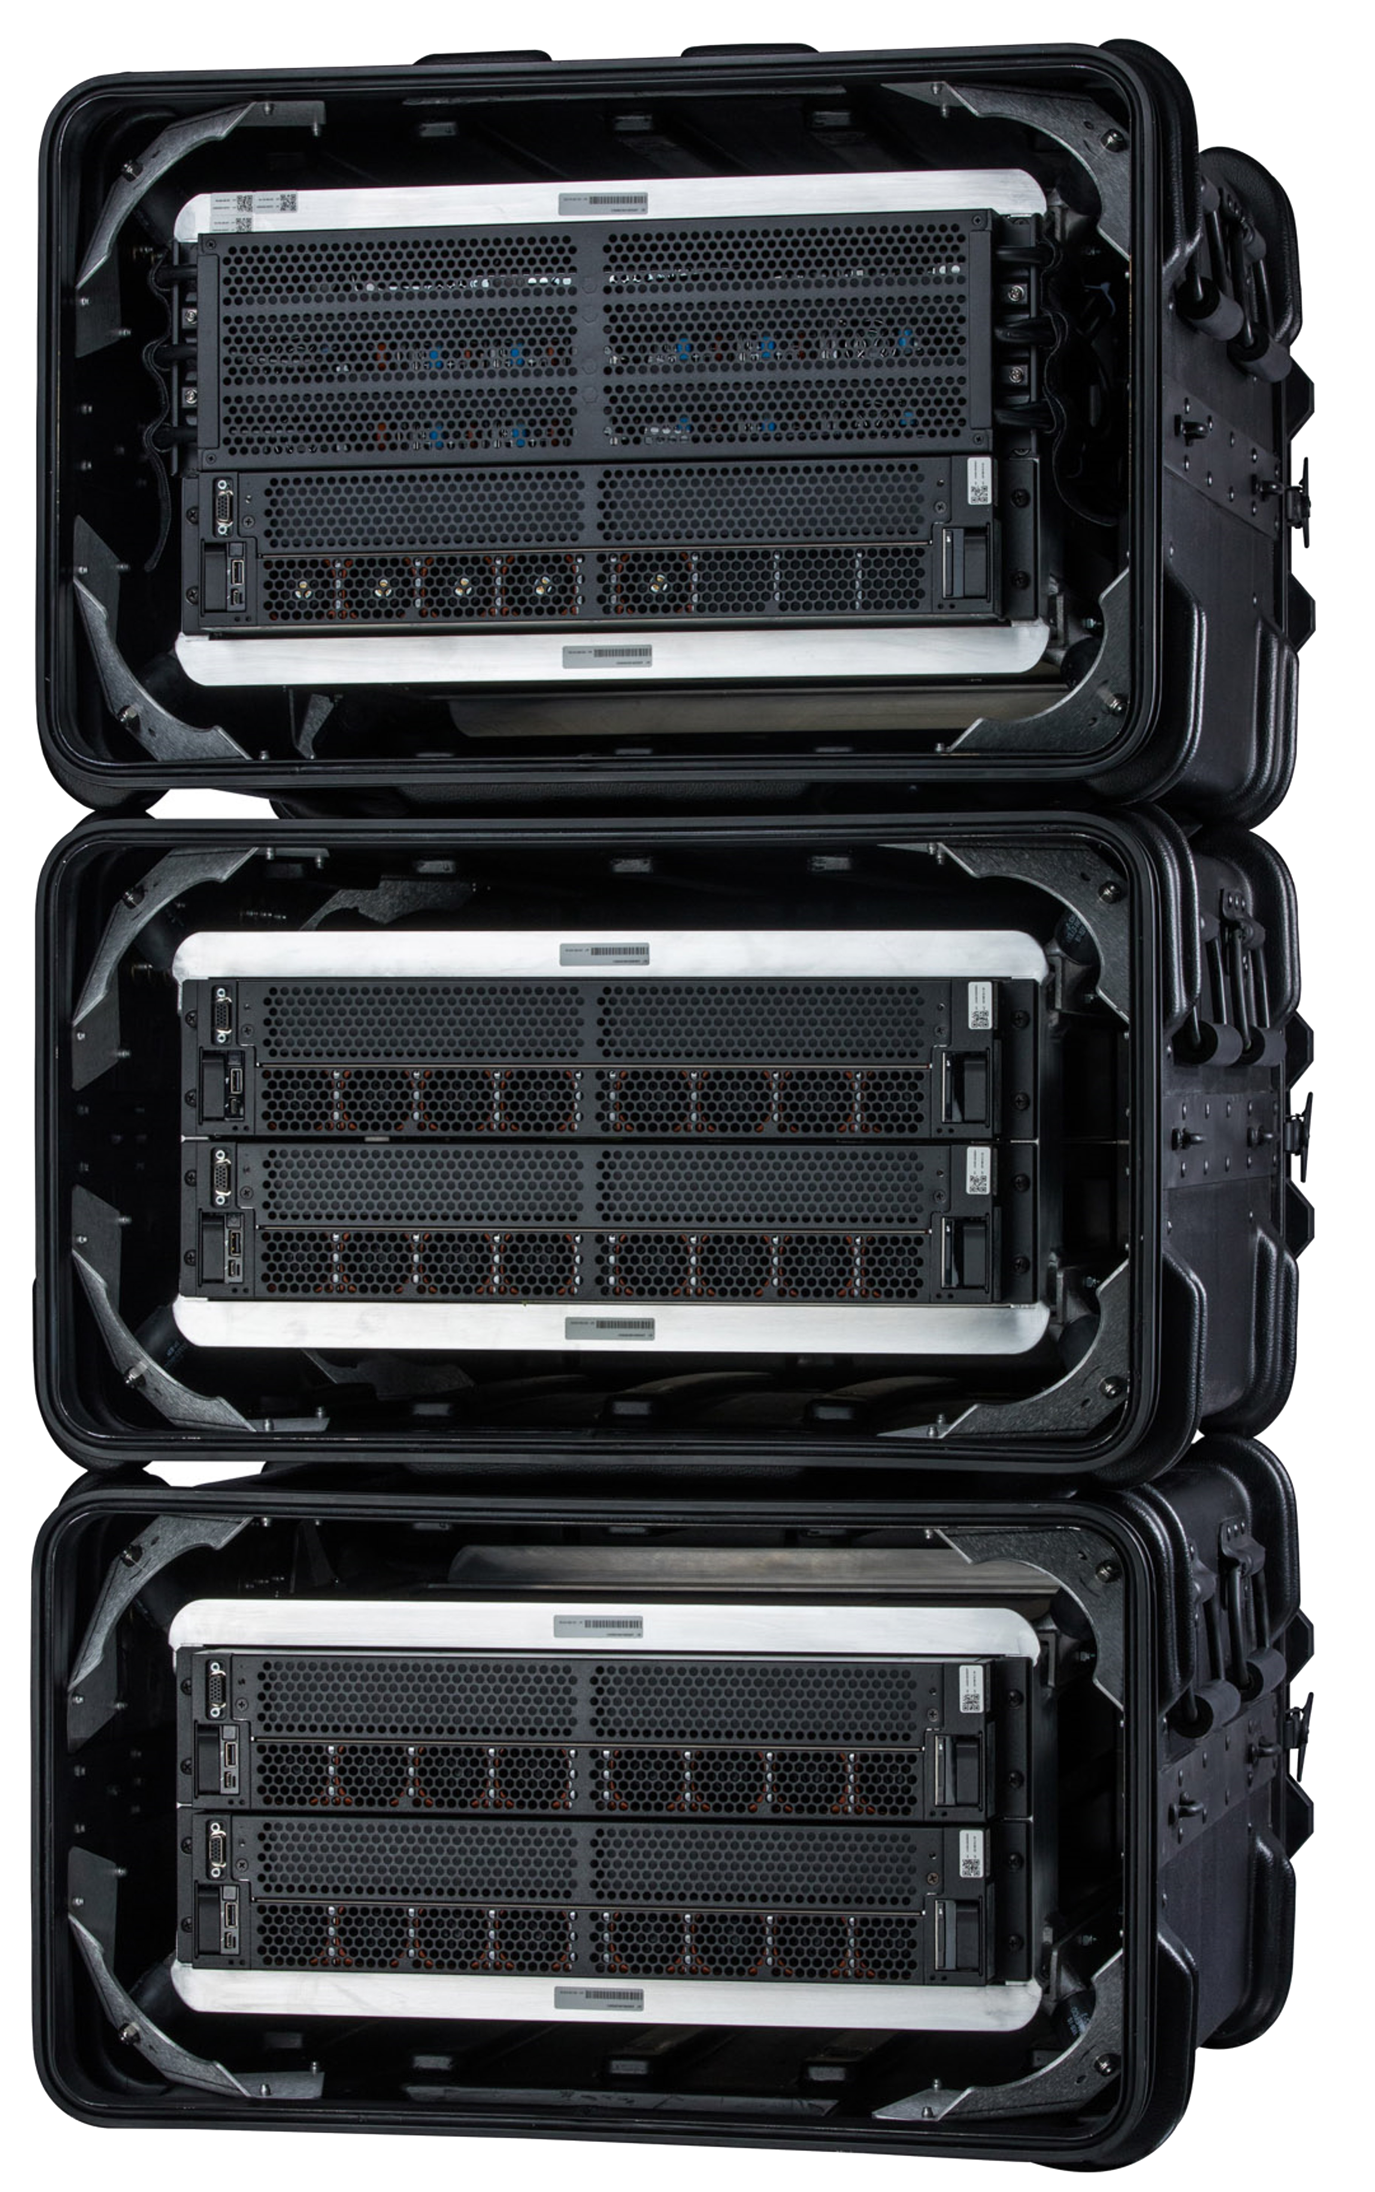
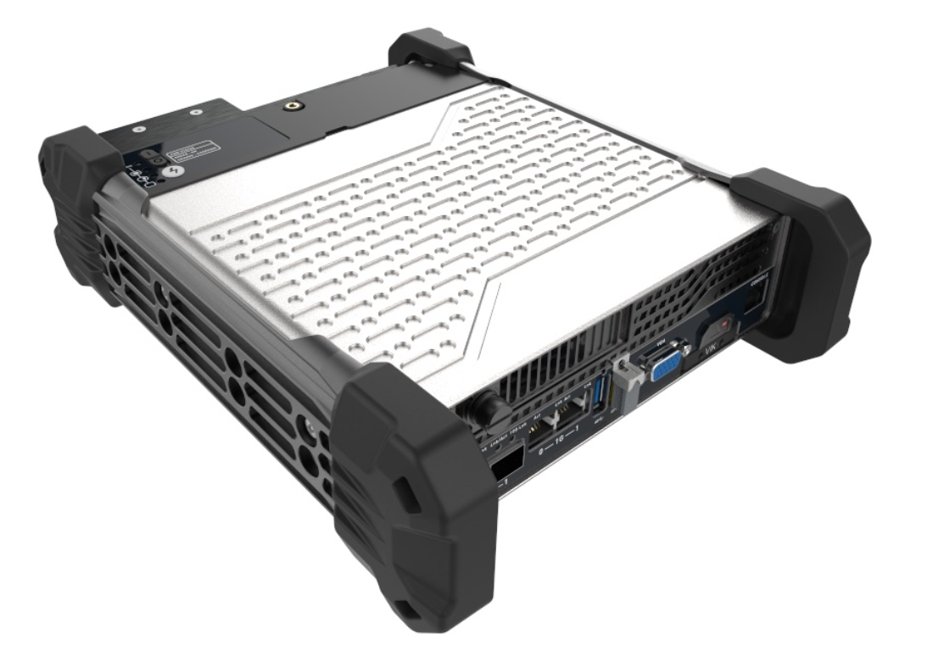
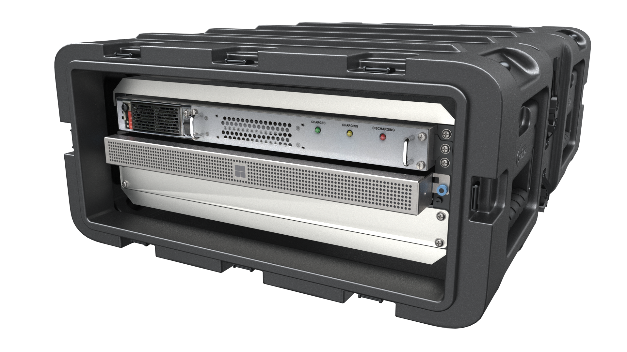
Rugged Edge Portfolio
Azure Stack Edge Mini R
Portable, Ruggedized Azure Stack Edge
Azure Stack Edge Pro R
Ruggedized Azure Stack Edge
Azure Stack Hub Ruggedized From Microsoft
Ruggedized Azure Stack Hub
Azure Modular
Data Center
Large scale Azure Stack Hub
Edge Compute Devices
Private Cloud Edge Devices

Slide 57
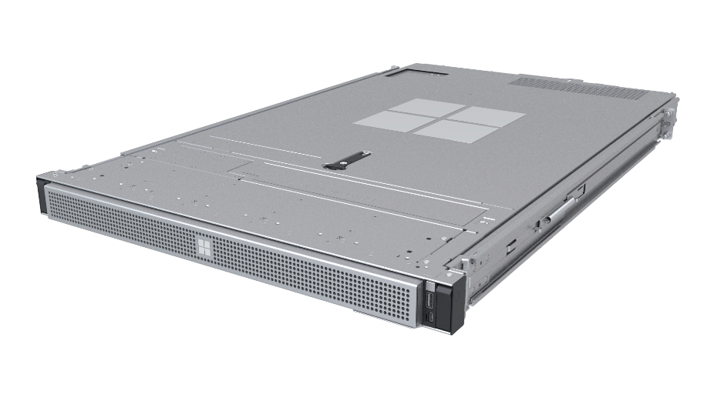
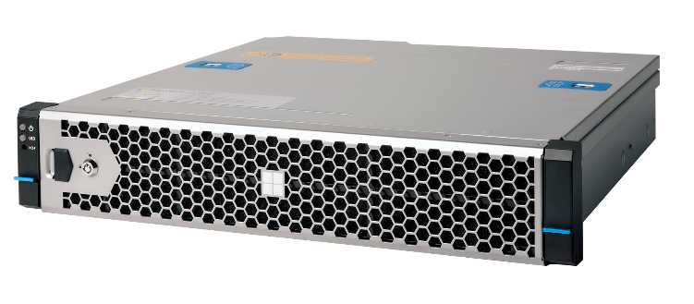
Azure Stack Edge Hardware
Commercial
Rugged
Enterprise-ready server with the option for one or two NVIDIA T4 Tensor Core GPUs
Ruggedized, portable, hardware-accelerated form-factors for harsh field conditions

Slide 58
Hardware as a Service
Our first party edge appliances are Hardware as a Service offerings
No need to purchase hardware upfront
Appliances are owned by Microsoft
Order and manage through Azure Portal
Microsoft is the single point of support
When done using them, cancel the Azure Service, appliances are returned to Microsoft

Slide 59
Questions?

Slide 61
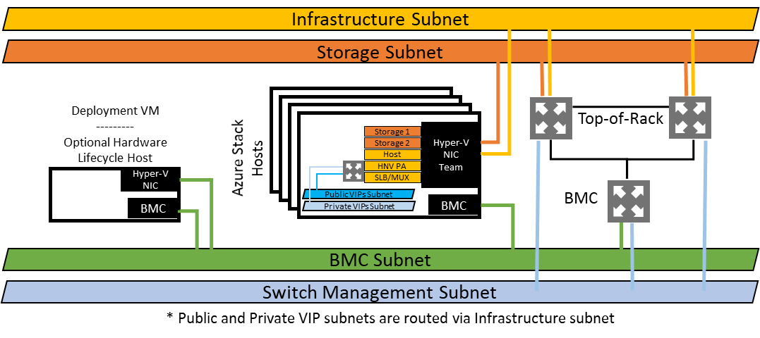
Logical network diagram

